Slide 1
EduShare: A Centralized Platform for Sharing Academic Resources
A Web Application
TEAM MEMBERS
Sundareswaran.M
Suriya.K.I
Shivaraman.G
MENTOR
Ms.JANSIRANI.A

Slide 2
OVERVIEW
ABSTRACT
INTRODUCTION
MOTIVATION
PROBLEM STATEMENT
OBJECTIVE
PROPOSED SOLUTION
WORK FLOW
BACKEND CONNECTION
DATABASE
ACTION PLAN
REFERENCES

Slide 3
ABSTRACT
EduShare is a web-based platform designed to simplify sharing academic resources within our department. It enables both staff and students to upload and access study materials, question banks, and notes efficiently. By categorizing resources and providing open access, EduShare aims to address challenges of disorganized file sharing currently done via WhatsApp groups and Google Classroom.

Slide 4

INTRODUCTION
Academic resources are essential for students' success.
Sharing materials via WhatsApp and Google Classroom often leads to clutter.
EduShare addresses this issue with a centralized platform for all resources.
Sharing study materials via WhatsApp often leads to disorganized chats, making it difficult to locate files.

Slide 5

MOTIVATION
Staff and students face difficulty in organizing and accessing files.
Need for a user-friendly platform to share and retrieve study materials.
Desire to improve efficiency in academic resource management.
Both staff and students struggle to organize and access academic files effectively, especially when using multiple platforms

Slide 6

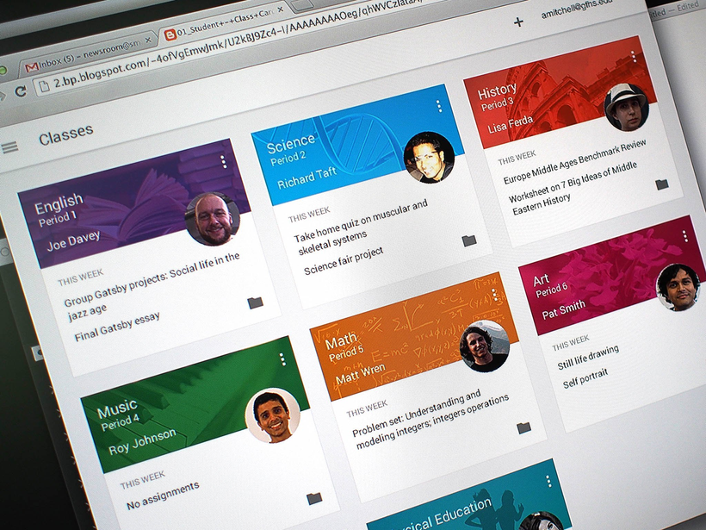
PROBLEM STATEMENT
Current methods like WhatsApp and Classroom are disorganized.
Difficult to find and retrieve old files.
No proper categorization or search functionality.
Need for a dedicated platform for efficient file sharing.
A specialized platform is required to streamline and simplify file sharing between staff and students.

Slide 7
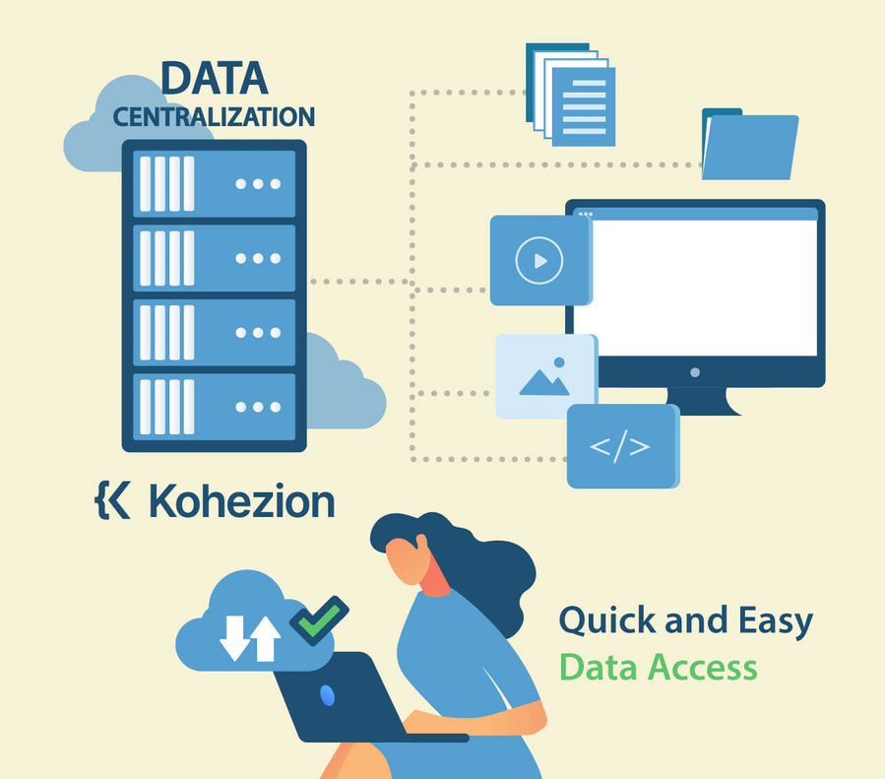
OBJECTIVE
Create a centralized platform for sharing academic resources.
Enable easy upload/download of materials.
Categorize files by subject, semester, and topic.
Provide open access to staff and students without reliance on classroom-based tools.

Slide 8
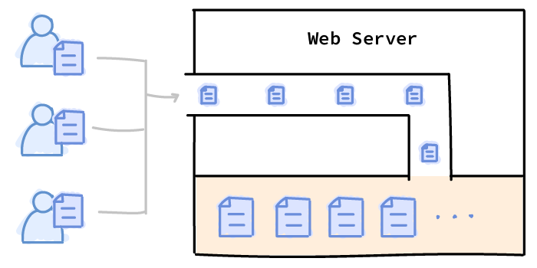
PROPOSED SOLUTION
Build a platform for uploading, downloading, and organizing files.
Categorize resources by subject, semester, and topics.
Provide a search/filter option to make retrieval easy.
Allow both staff and students to upload and access files freely.
Users (both staff and students) can easily upload and download academic resources.

Slide 9
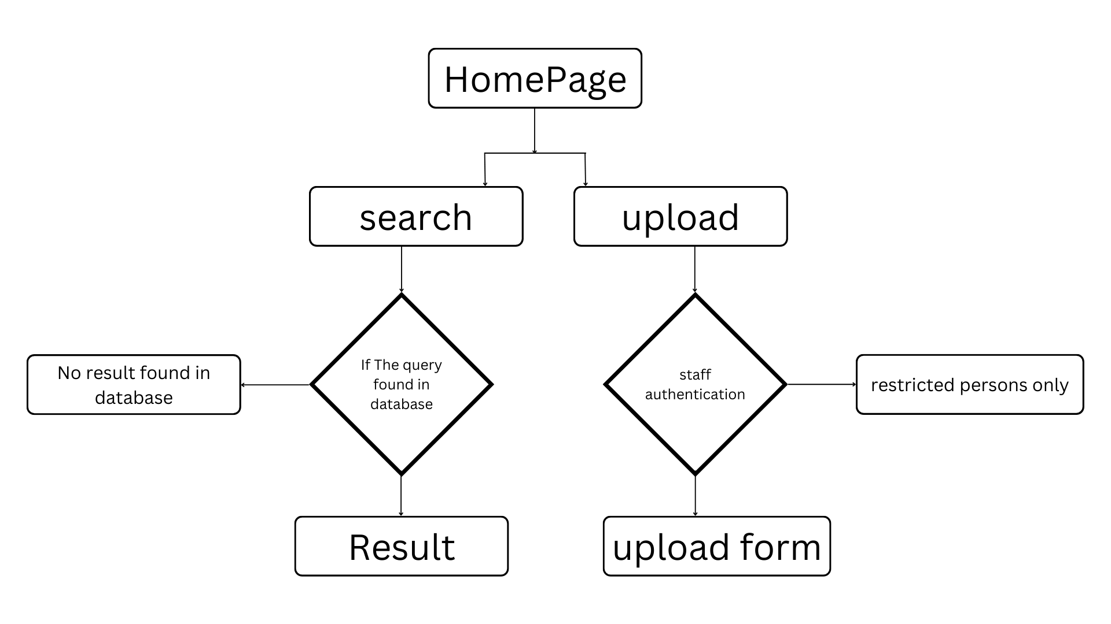
WORK FLOW

Slide 10
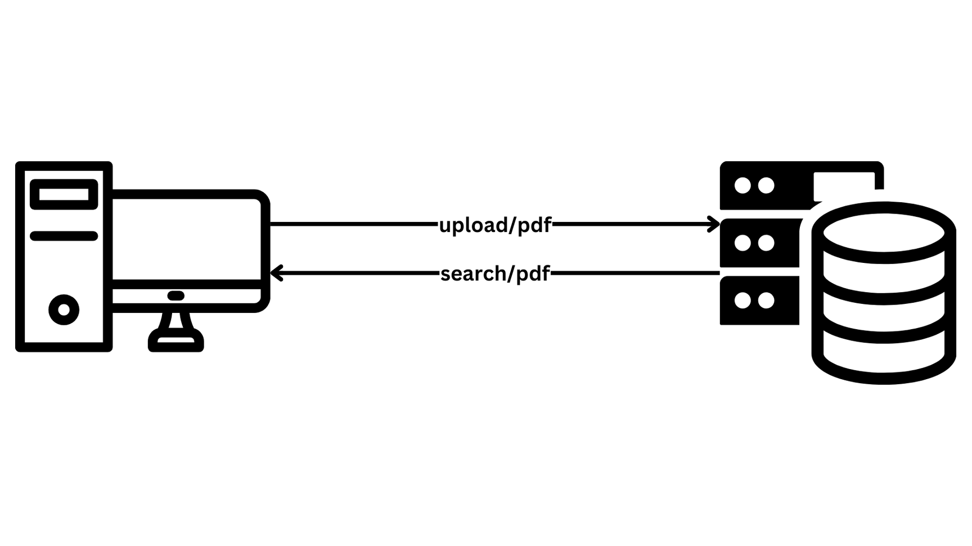
BACKEND CONNECTION

Slide 11
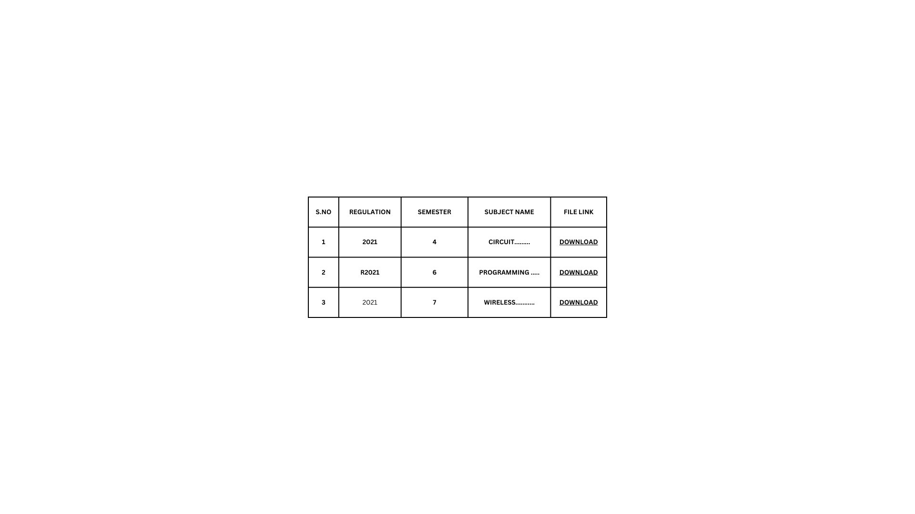
DATABASE

Slide 12


ACTION PLAN
Literature review, tool selection, and initial design.
Database setup and basic file upload/download functionality.
Develop frontend and implement categorization features.
Testing, feedback, and deployment.

Slide 13
REFERENCES
[1] John Smith, Emily Johnson, "Enhancing Educational Resource Sharing Platforms: Challenges and Opportunities" in proceedings of IEEE Transactions on Learning Technologies, Vol. 15, Issue 3, 2022, PP 123-130.
[2] Alex Brown, Sarah Thompson, "A Comparative Study of Online Learning Management Systems" in proceedings of Springer Advances in Education Research, Vol. 9, 2021, PP 45-50.
[3] Michael Green, Lisa White, "Improving File Organization in Academic Settings" in proceedings of Elsevier Journal of Educational Technology, Vol. 25, Issue 4, 2020, PP 98-105.

Slide 14


